Slide 1


Teacher Collaboration Platform
A social media app for teachers to collaborate and share resources.

Slide 2
Problem Statement
Lack of Collaboration and Resource Sharing
Teachers currently lack a dedicated platform for collaboration and resource sharing.
Existing social media platforms are not designed specifically for the needs of educators.
Need for a Specialized Social Media Web App
A specialized social media web app can provide teachers with a platform tailored to their unique requirements.
This app would facilitate collaboration, resource sharing, and professional development opportunities among educators.

Slide 3
Ideas Brief
1
A platform where teachers can present their portfolio, and present their work like question papers, notes, research work, and other things.
2
Availability of tools specially designed for teachers - PPT, Notemaking, paper, and a workspace.
3
A place where you can easily hire teachers (freelancing workspace for teachers)
A platform where students can look for teachers according to subjects.
A platform where students wants to learn in their own language.
A place for teachers where they can interact with each other and more

Slide 4

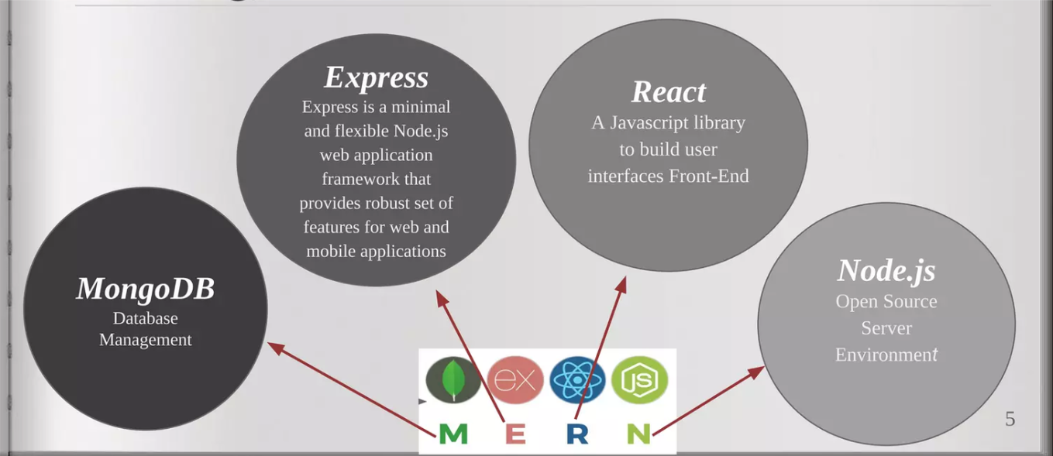
Technology stack

Slide 5

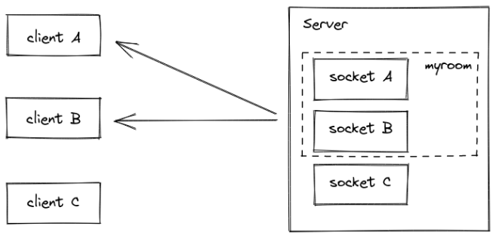
AWS:For hosting the web application.
SOCKET.IO:For real-time features like notifications.

Slide 6



Platform Features
User Profile & Portfolio
Marketplace
Personal Workspace
Enables teachers to showcase their skills and experience.
Facilitates job searches and applications for teaching positions.
Organizes resources, schedules, and lesson plans.

Slide 7
Additional Features
AI Tools
Collaboration Space
Integrates artificial intelligence for enhanced teaching experiences.
Connects teachers for idea sharing and forums.
Chat Bot Integration
Feedback & Review System
Provides automated assistance for teachers.
Enables schools and individuals to provide feedback and ratings.

Slide 8
Search & Security
1
Search Bar
2
Login and Security
Allows specific teacher searches, including regional languages and subjects.
Ensures secure access to the platform.

Slide 9
Frontend Development
1
User Interface
2
Job Board
Engaging and user-friendly design for seamless navigation.
Provides a platform for job searches and applications.

Slide 10
Backend Development
1
Database Management
2
Socket.io Integration
Efficient storage and retrieval of user and resource data.
Enables real-time communication and data exchange.

Slide 11
Prototype Video/Photos
1
Video Demonstration
2
Image Gallery
Visual representation of the platform's features and functionality.
Illustrations of the platform's interface and user interactions.

Slide 12
Conclusion
1
Professional Development
2
Seamless Connection
Enhances teacher collaboration and resource sharing for improved professional growth.
Facilitates easy and efficient communication among educators.

Slide 13

DETAILS OF THE TEAM
Team Name: Tech Canvas.
Team Members:
Zoya Iftekhar,
Anam Ilahi,
Nida Fatima
Institute Name: JAMIA HAMDARD
Theme Name: Education

Slide 14


THANK YOU

